Slide 1
AutoSAP URL monitoring

Slide 2

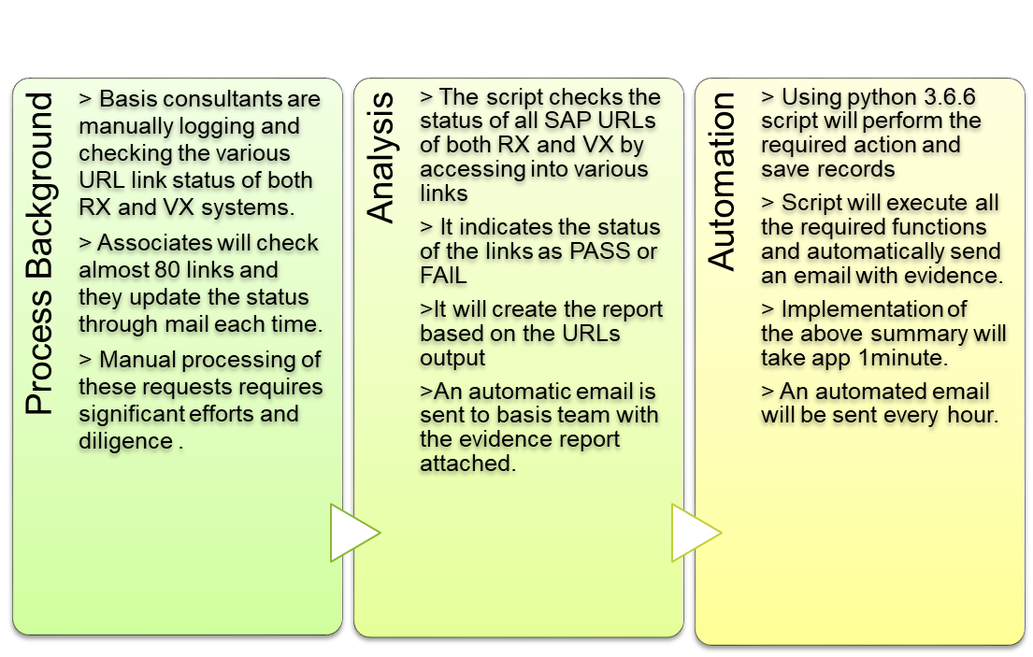
AutoSAP URL Monitoring
Business Value
95%
  Reduction in execution time
100%
  Data Accuracy
Zero
  Manual intervention
Evidence
  Better Documentation
167 Hours
  Efforts saved per month

Slide 3
AutoSAP Basis URL Monitoring Workflow Chart:
Login to SAP URL links of RX and VX systems.
Repeat for each link
Script checks status and indicates PASS or FAIL
It creates a report indicating status of all URLs
Send email with evidence indicating subject line as Action required if any 1status fails or else Green(no action required)

Slide 4
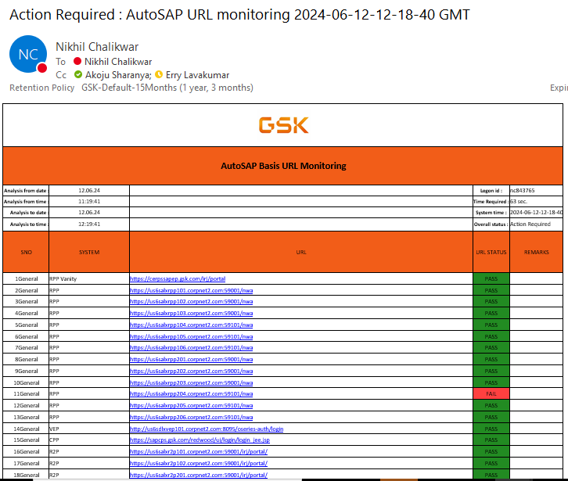
Mail Template

Slide 5
Q&A

Slide 6
Thank You

